Slide 1
Pressure measurement methods

Slide 3
McLeod gauge
Resolution = ± 0.1 mmHg
Rotation traps gas

Slide 4
Manometers – measure differential pressure

Slide 5
Diaphragm pressure gauges Good frequency response, cheap

Slide 6
Capacitive based diaphragm transducer More sensitive

Slide 7
Piezoelectric-based diaphragm transducer Much higher frequency response

Slide 8
Dynamics of pressure tap systems Speed of sound in air = 343 m/sec, 1 meter takes ~ 3 msec
Inertance
Fluid resistance
Compliance

Slide 9
Dynamics of pressure tap systems
Differential equation describing behavior of one dimensional system
a = speed of sound in gas
ρ = gas density
D = ID of tube
µ = fluid viscosity
Two possible solutions for gases. First solution is general. Second solution is for situation where the volume of the transducer, V, is much smaller than the volume of the tube.
V = transducer volume
V_{t} = tube volume

Slide 10
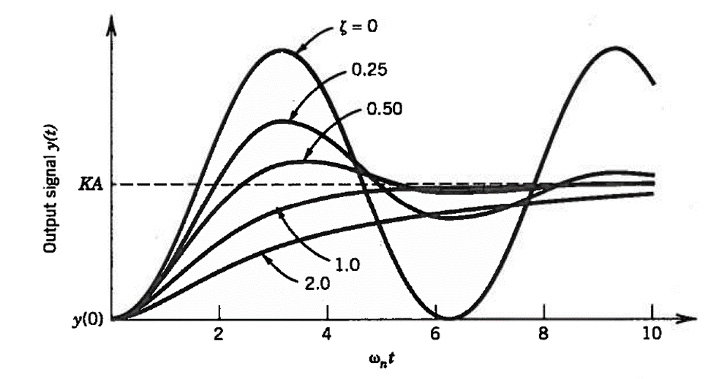
Step function response of a second order system

Slide 11
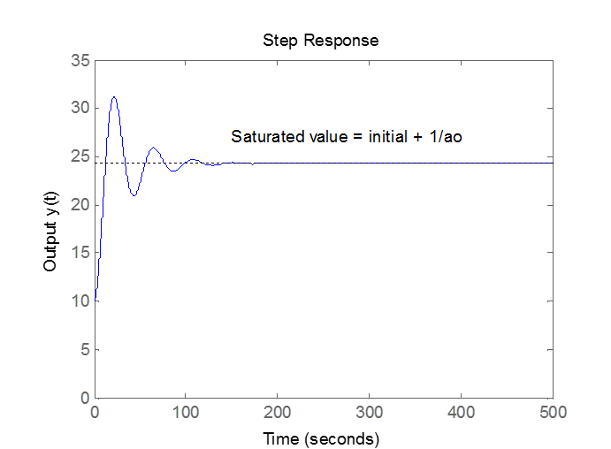
Ideal step function response for underdamped system

Slide 12
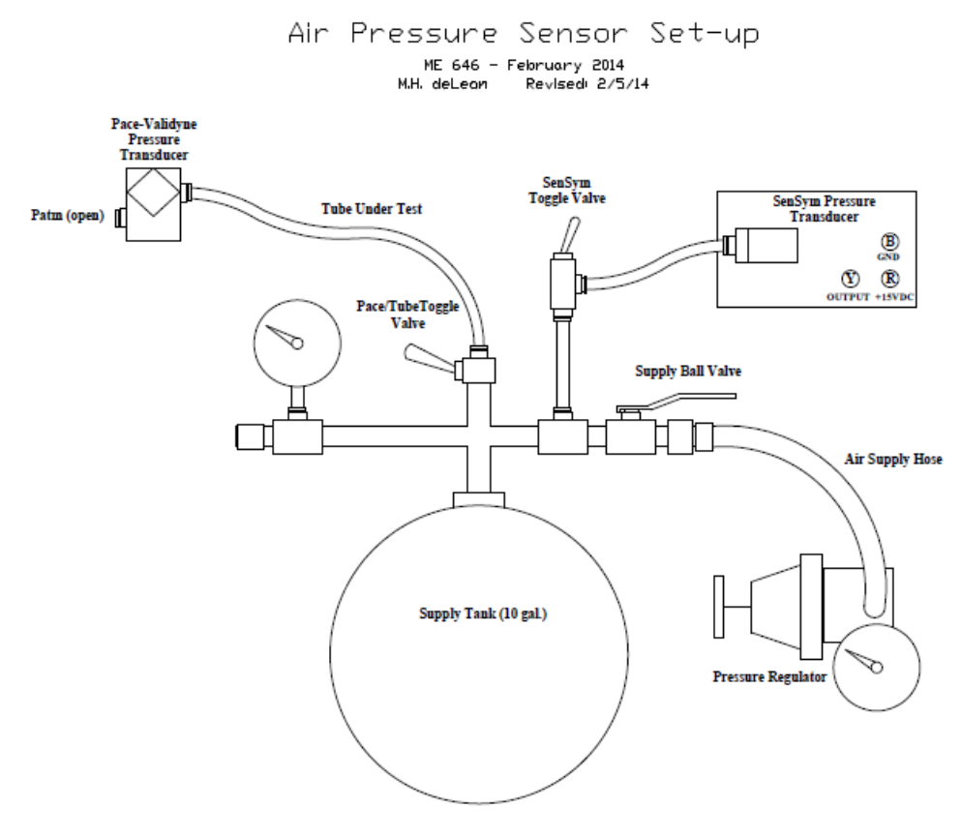
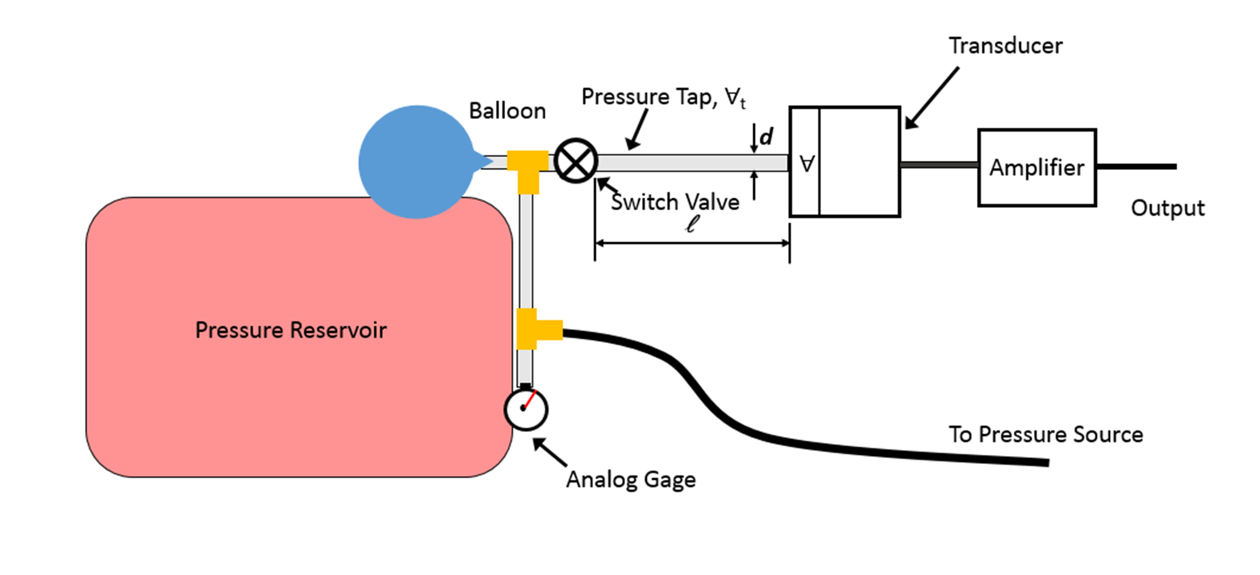
Research questions:
Can we use a ramp input to obtain the damping ratio and natural frequency?
What is the dependence of damping ratio and natural frequency on tube length and does it follow the second order model?
Provides ramp input
Provides step input

Slide 13

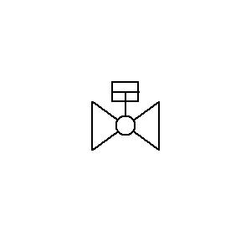
Simulated step input to pressure tap
Pressure source
Pressure tap
Pressure sensor

Slide 14
Assume one can obtain ω_{n} and ζ from the data for different tube lengths. How can we compare the system response to the model?
Assume tube volume much greater than sensor volume.
Can compare magnitudes of slopes but dependence is a good indicator.

Slide 15
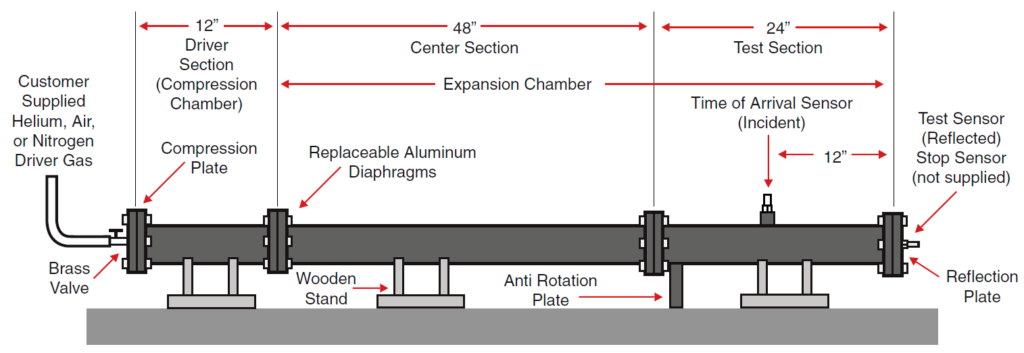
How do you measure the dynamic characteristics of a pressure transducer?

Slide 16
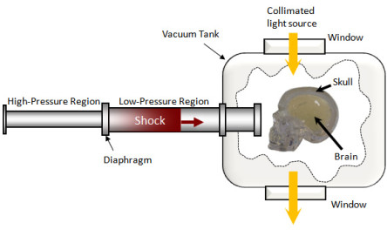
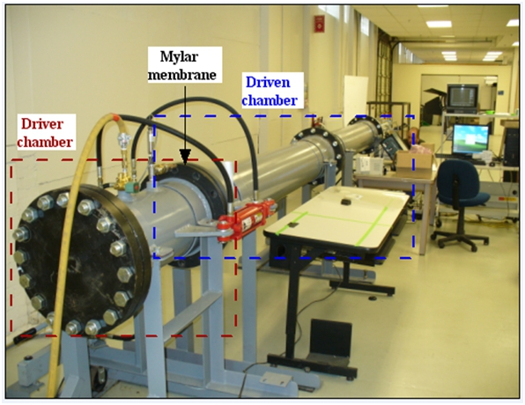
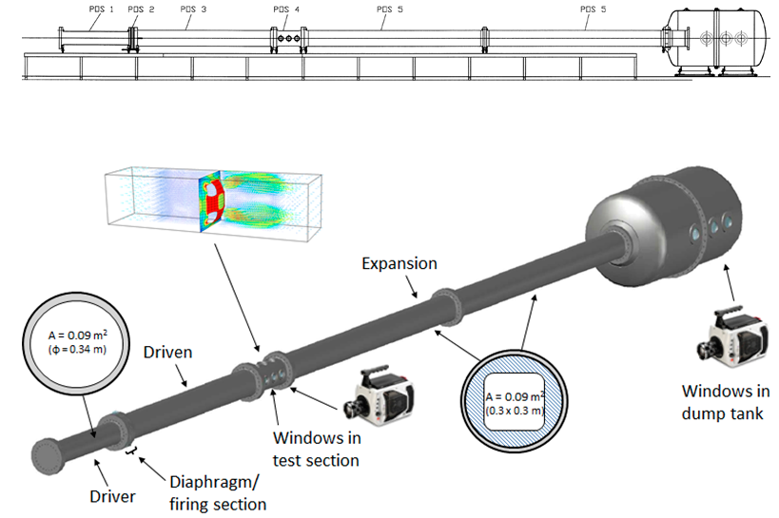

Slide 17
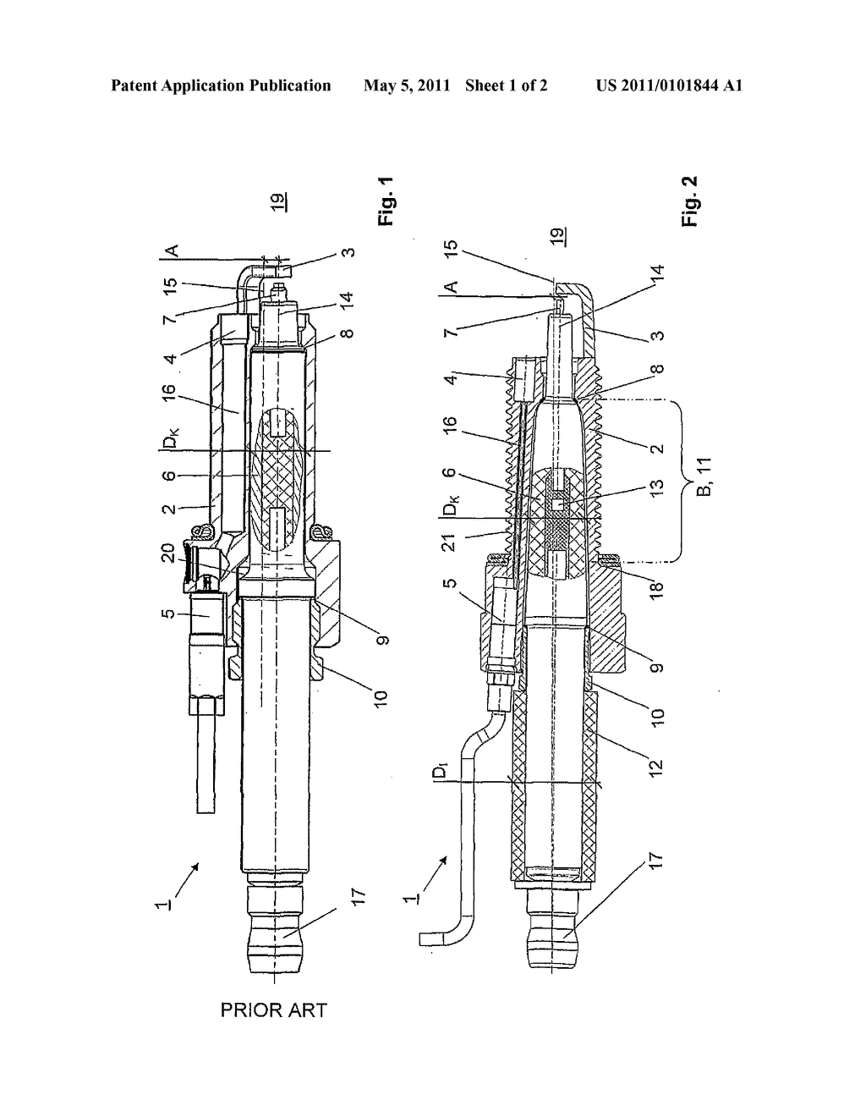
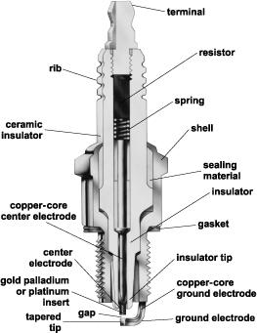
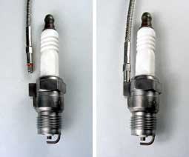
Spark plug pressure sensor
Sensor

